Slide 1

Altitude control of Cessna Citation 500 aircraft
Crippa Davide 509769
Moroni Gianluca 503424
Mongini Paolo 507997
Bordonali Mattia 496468
Notes:
NOTA:
per cambiare l'immagine in questa diapositiva, selezionarla ed eliminarla. Quindi fare clic sull'icona Immagini nel segnaposto per inserire l'immagine desiderata.

Slide 2
Introduction
Data
States:
$x_{1}$: Angle of attack [rad]
𝑥_1: Angle of attack [rad]
$x_{2}$: Pitch angle [rad]
𝑥_2: Pitch angle [rad]
$x_{3}$: Pitch rate [rad/s]
𝑥_3: Pitch rate [rad/s]
$x_{4}$: Altitude [m]
𝑥_4: Altitude [m]
Inputs:
$u$: Elevator angle [rad]
𝑢: Elevator angle [rad]

Slide 3
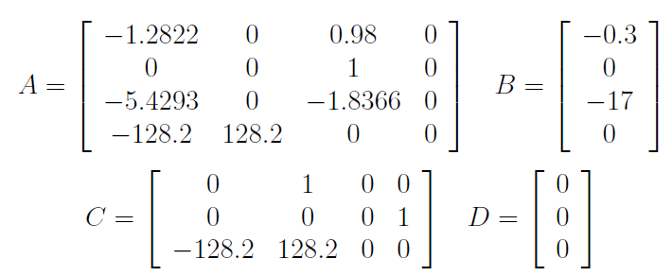
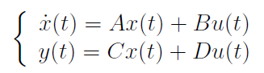
Introduction
Model
The model is linearized at an altitude of 5000 m and a speed of 128.2 m/sec

Slide 4
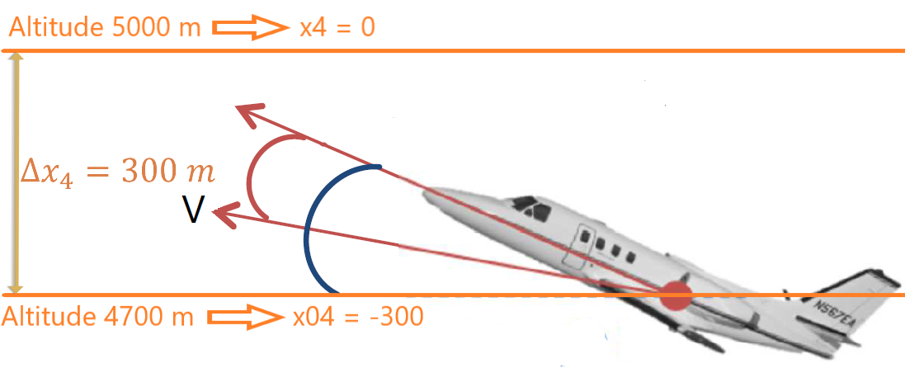
Introduction
Constraints
Elevator angle ($u$): $±15° (±0,262$rad)
Elevator angle (𝑢): ±15° (±0,262 rad)
Pitch angle ($x_{2}$): $±20°$ ($±0,349$ rad)
Pitch angle (𝑥_2): ±20° (±0,349 rad)
Elevator slew rate: $±30°/sec$ ($±0,524$ rad/s)
Elevator slew rate: ±30°/𝑠𝑒𝑐 (±0,524 rad/s)
Initial States
$x_{01}$: Angle of attack = 0°
𝑥_01: Angle of attack = 0°
$x_{02}$: Pitch angle = 15° = 0.2618 rad
𝑥_02: Pitch angle = 15° = 0.2618 rad
$x_{03}$: Pitch rate = 0 rad/s
𝑥_03: Pitch rate = 0 rad/s
$x_{04}$: Altitude = -300 m
𝑥_04: Altitude = -300 m

Slide 5
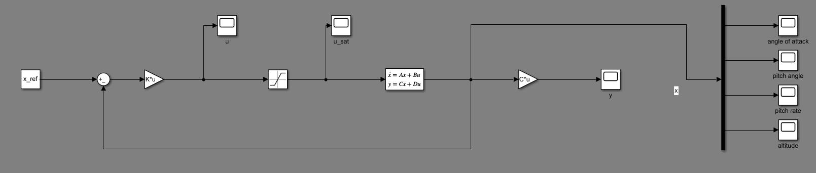
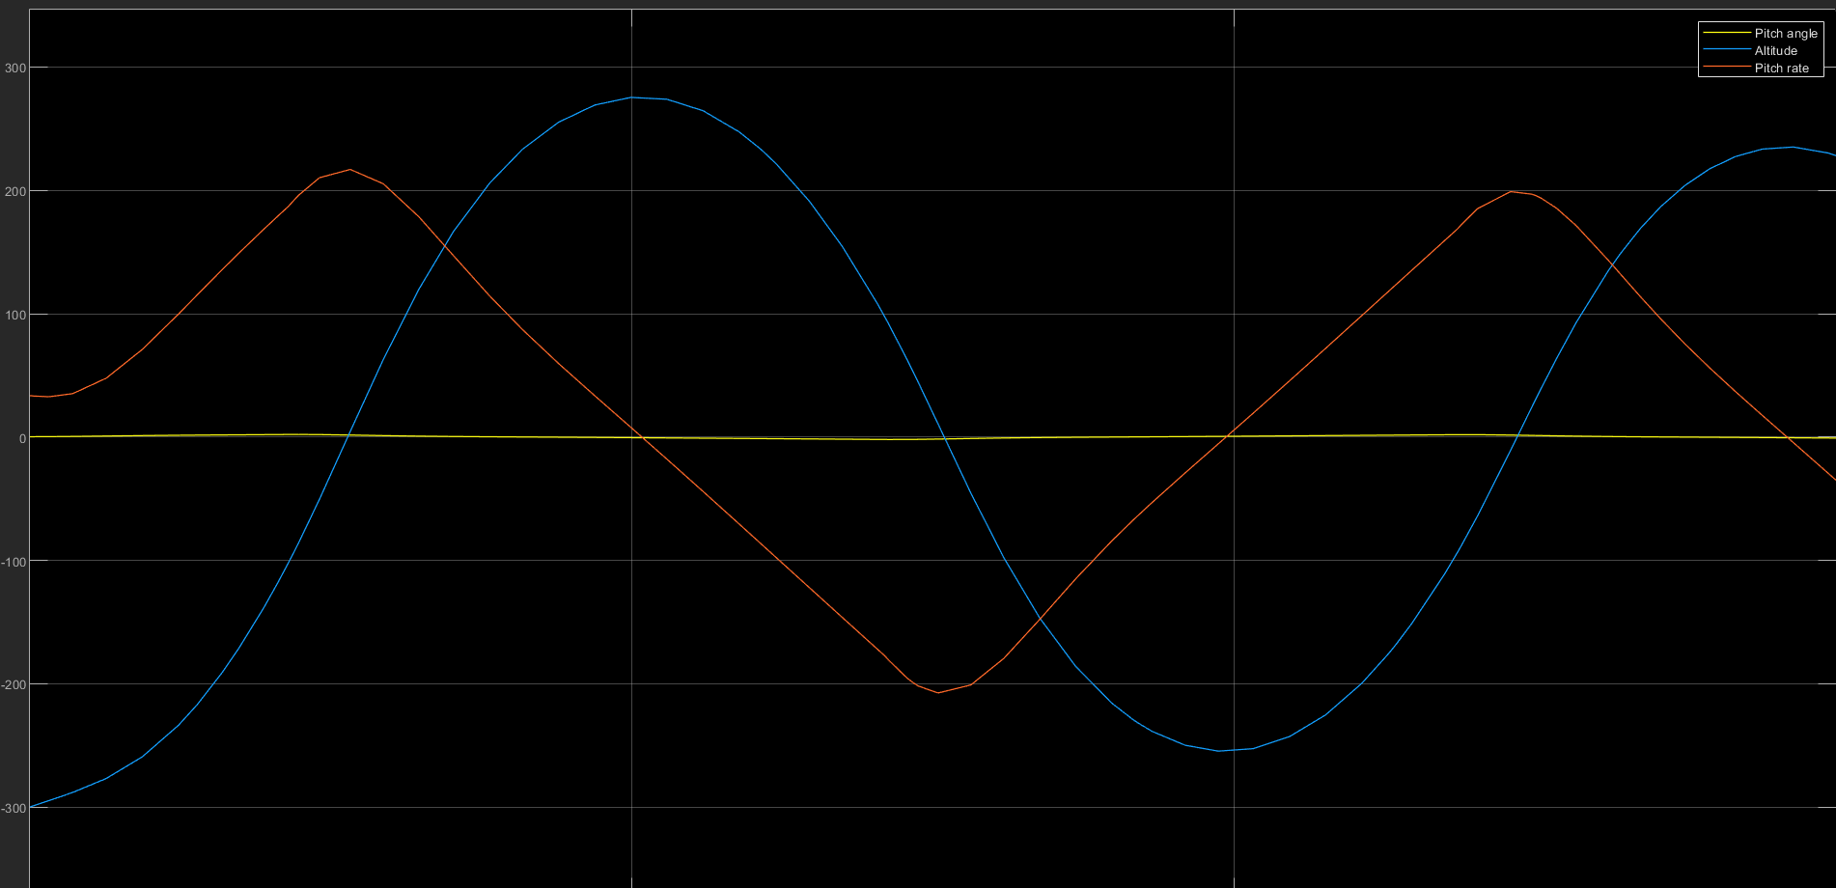
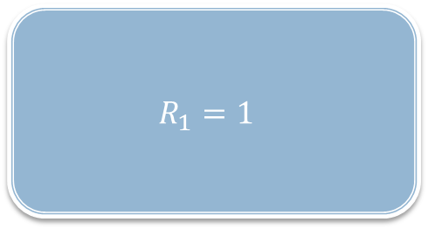
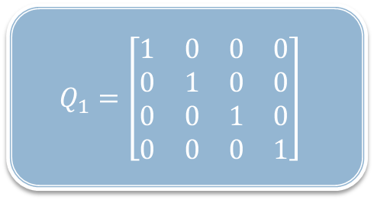
LQ Controller: 1° attempt
$$Q_{1}=\left[\begin{matrix}1 & 0 & 0 & 0 \\ 0 & 1 & 0 & 0 \\ 0 & 0 & 1 & 0 \\ 0 & 0 & 0 & 1\end{matrix}\right]$$
$$R_{1}=1$$

Slide 6
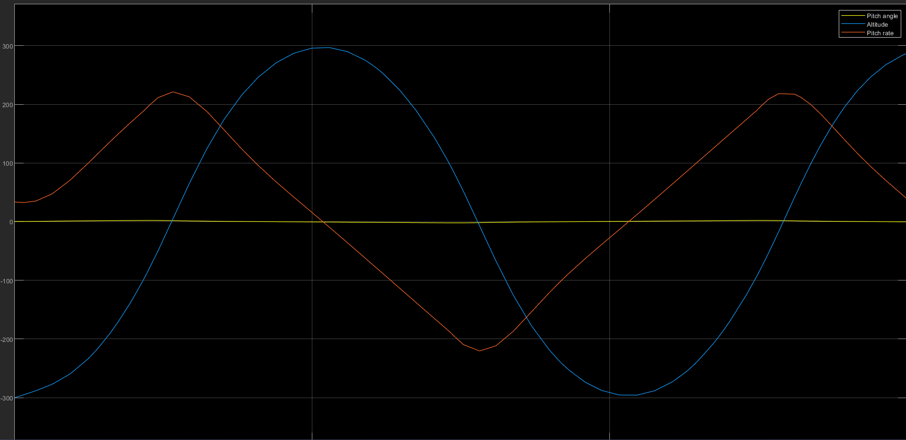

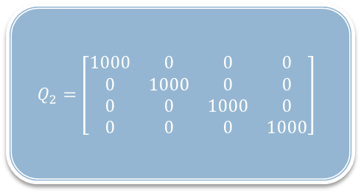
LQ Controller: 2° attempt
$$Q_{2}=\left[\begin{matrix}1000 & 0 & 0 & 0 \\ 0 & 1000 & 0 & 0 \\ 0 & 0 & 1000 & 0 \\ 0 & 0 & 0 & 1000\end{matrix}\right]$$
$$R_{2}=1$$

Slide 7
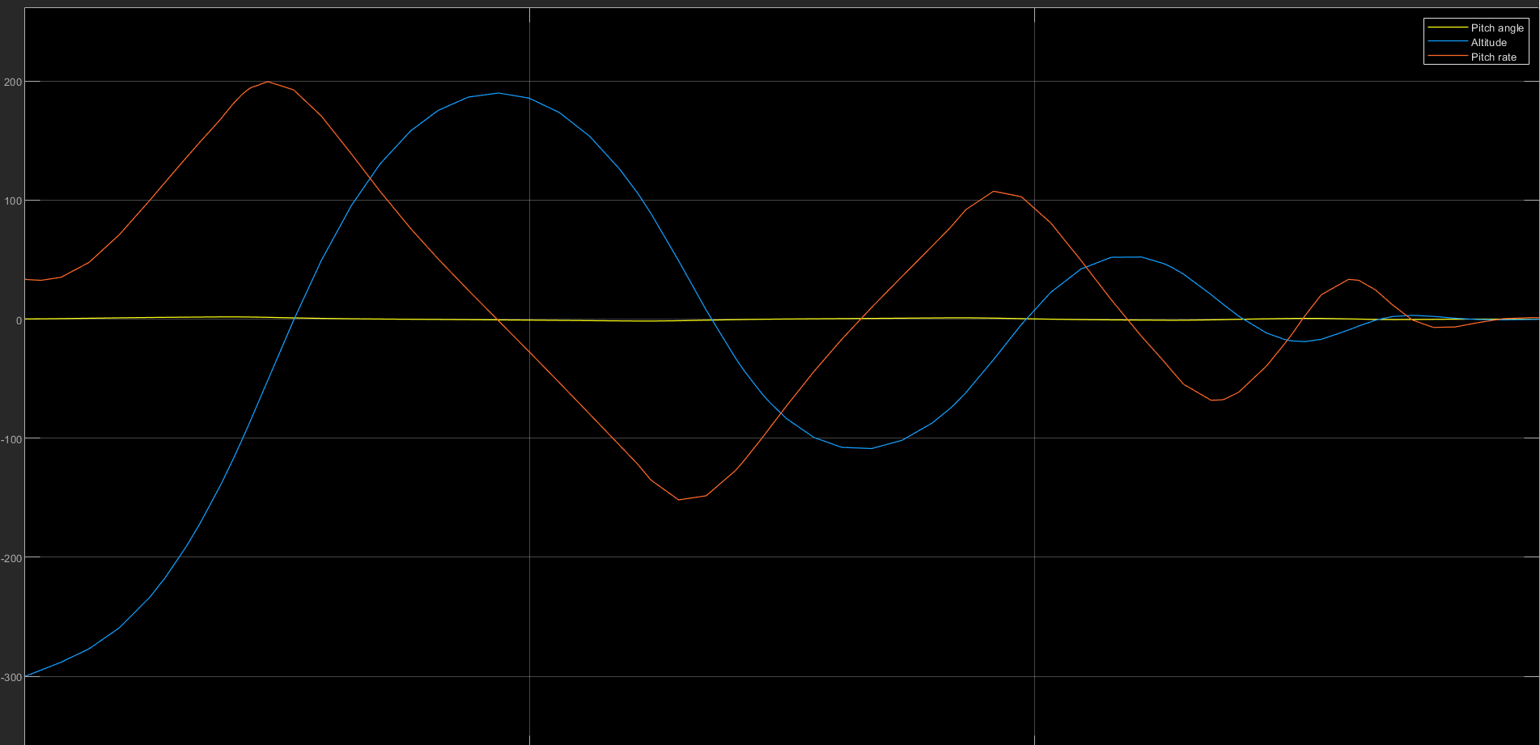
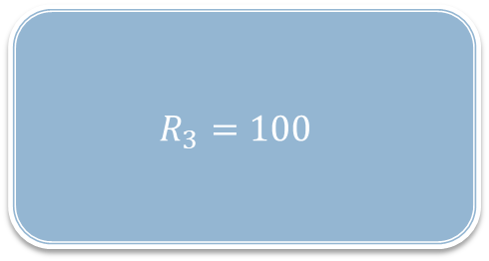
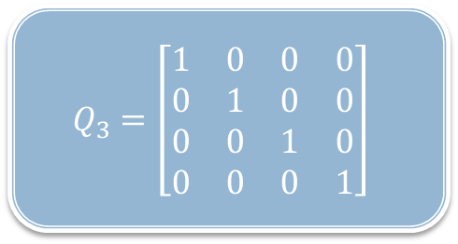
LQ Controller: 3° attempt
$$Q_{3}=\left[\begin{matrix}1 & 0 & 0 & 0 \\ 0 & 1 & 0 & 0 \\ 0 & 0 & 1 & 0 \\ 0 & 0 & 0 & 1\end{matrix}\right]$$
$$R_{3}=100$$

Slide 8
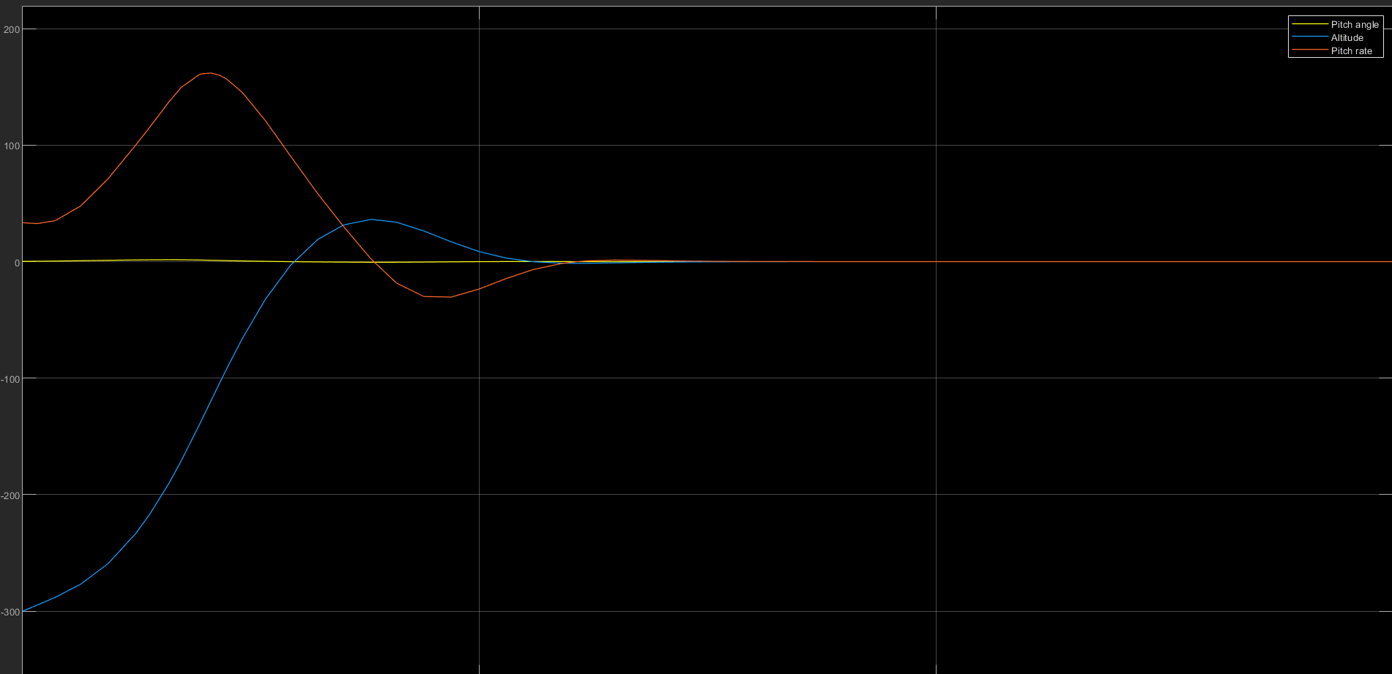
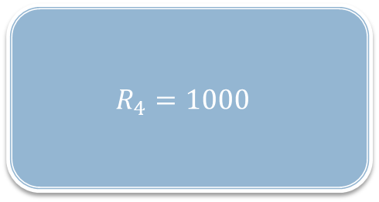

LQ Controller: 4° attempt
$$Q_{4}=\left[\begin{matrix}1 & 0 & 0 & 0 \\ 0 & 1 & 0 & 0 \\ 0 & 0 & 1 & 0 \\ 0 & 0 & 0 & 1\end{matrix}\right]$$
$$R_{4}=1000$$

Slide 9
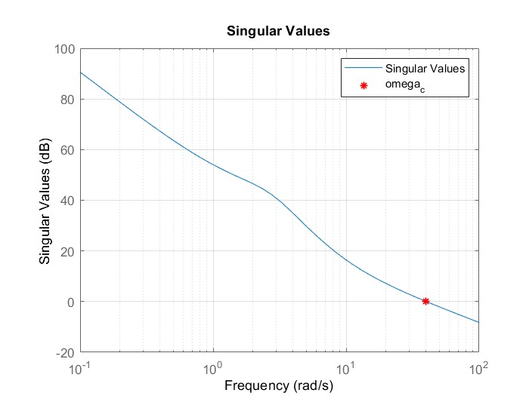
LQ Controller Discrete Time
Shannon Theorem
$$ω_{sampling}>2∗ω_{c}$$
𝜔_𝑠𝑎𝑚𝑝𝑙𝑖𝑛𝑔>2∗𝜔_𝑐
$$T_{sampling}=\frac{2∗π}{ω_{c}}=0,0793 s$$
𝑇_𝑠𝑎𝑚𝑝𝑙𝑖𝑛𝑔=(2∗𝜋)/𝜔_𝑐 =0,0793 𝑠
$$ω_{sampling}=2∗π∗f_{sampling}=\frac{2∗π}{T_{sampling}}$$
𝜔_𝑠𝑎𝑚𝑝𝑙𝑖𝑛𝑔=2∗𝜋∗𝑓_𝑠𝑎𝑚𝑝𝑙𝑖𝑛𝑔=(2∗𝜋)/𝑇_𝑠𝑎𝑚𝑝𝑙𝑖𝑛𝑔
$$f_{sampling}=\frac{1}{T_{sampling}}$$
𝑓_𝑠𝑎𝑚𝑝𝑙𝑖𝑛𝑔=1/𝑇_𝑠𝑎𝑚𝑝𝑙𝑖𝑛𝑔

Slide 10
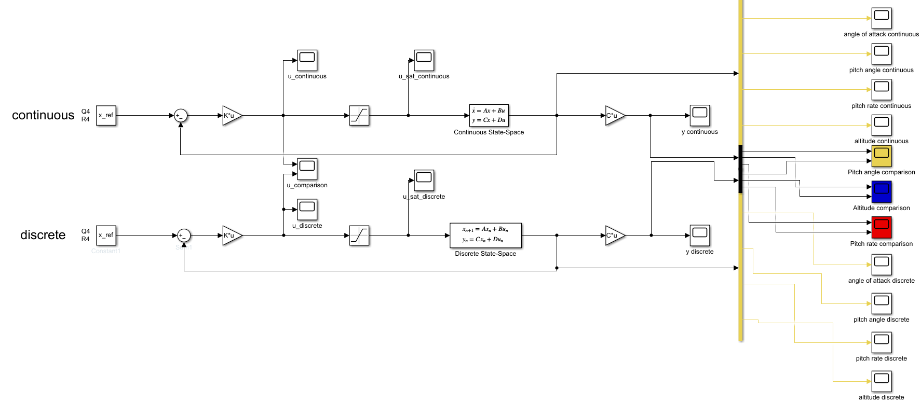
LQ Controller Discrete Time
Simulink Scheme: Discretized Controller ($Q_{4}$, $R_{4}$)
Simulink Scheme: Discretized Controller (𝑄_4, 𝑅_4)

Slide 11
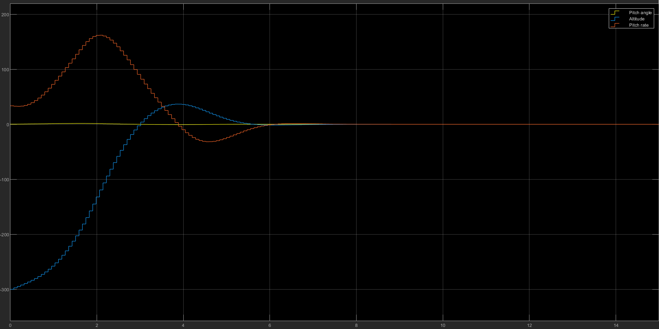
LQ Controller Discrete Time
Results for Discretized Controller

Slide 12
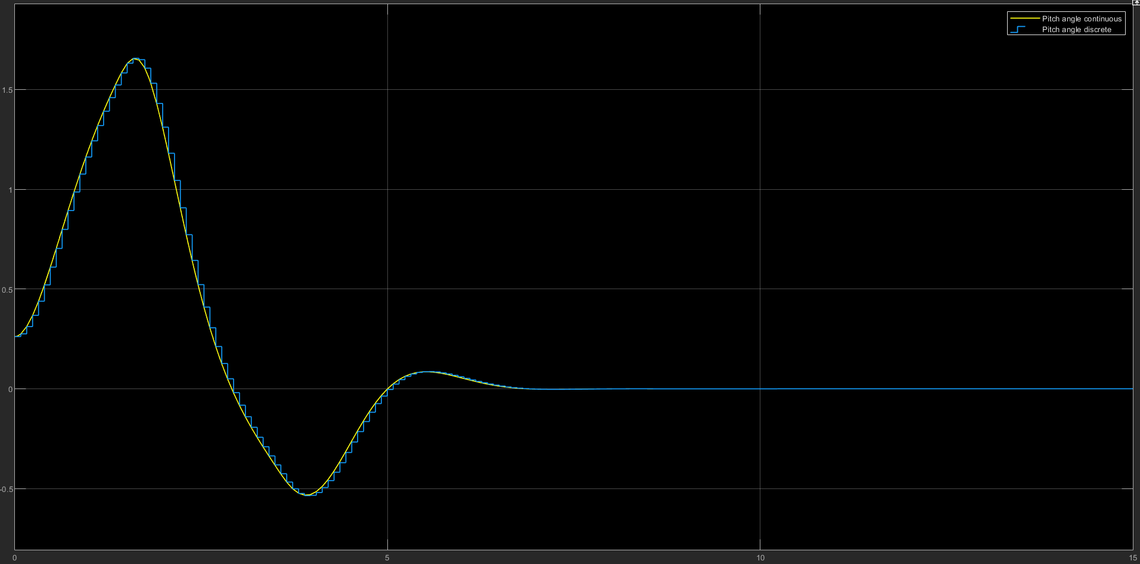
LQ Controller Discrete Time
Comparison between Continuous and Discrete: Pitch Angle

Slide 13
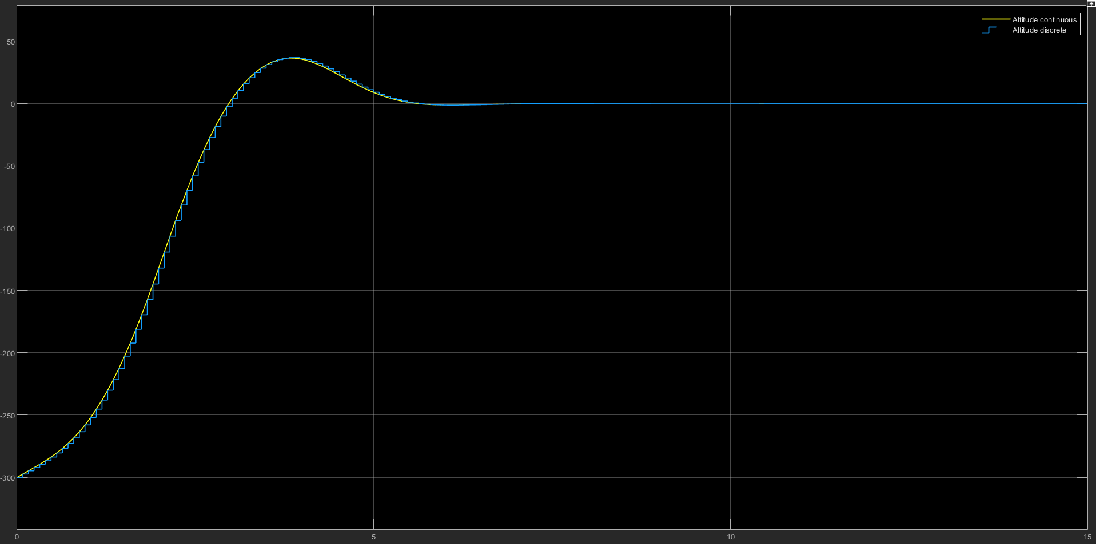
LQ Controller Discrete Time
Comparison between Continuous and Discrete: Altitude

Slide 14
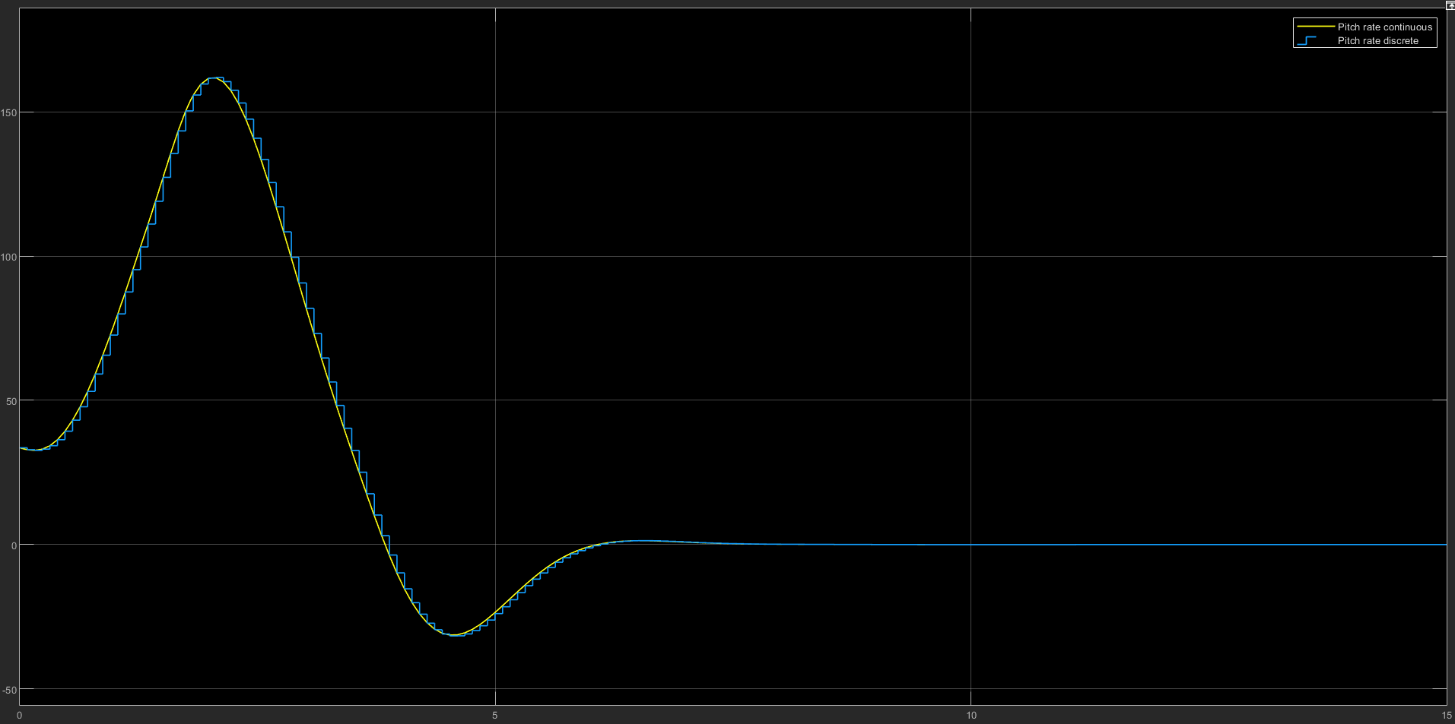
LQ Controller Discrete Time
Comparison between Continuous and Discrete: Pitch Rate

Slide 15
MPC Controller
MPC of linear systems in state space form
$$Model:\left\{\begin{aligned}x\left(k+1\right)=A x\left(k\right)+B u(k) \\ y\left(k\right)=C(k)\end{aligned}\right.$$
𝑀𝑜𝑑𝑒𝑙:{█(𝑥(𝑘+1)=𝐴 𝑥(𝑘)+𝐵 𝑢(𝑘)@𝑦(𝑘)=𝐶(𝑘))┤
$$Cost function:J\left(x\left(k\right),u\left(.\right),k\right)=\sum_{i=0}^{N−1}{\left({\left\|x(k+i)\right\|}_{Q}^{2}+{\left\|u(k+i)\right\|}_{R}^{2}\right)+{\left\|x(k+N)\right\|}_{S}^{2}}$$
𝐶𝑜𝑠𝑡 𝑓𝑢𝑛𝑐𝑡𝑖𝑜𝑛:𝐽(𝑥(𝑘),𝑢(.),𝑘)=∑24_(𝑖=0)^(𝑁−1)▒〖(‖𝑥(𝑘+𝑖)‖_𝑄^2+‖𝑢(𝑘+𝑖)‖_𝑅^2 )+‖𝑥(𝑘+𝑁)‖_𝑆^2 〗
$$N→Prediction horizon$$
𝑁→𝑃𝑟𝑒𝑑𝑖𝑐𝑡𝑖𝑜𝑛 ℎ𝑜𝑟𝑖𝑧𝑜𝑛
$$Q=Q^{′}≥0, R=R^{′}>0,S=S′≥0$$
𝑄=𝑄^′≥0, 𝑅=𝑅^′>0,𝑆=𝑆′≥0
$$x∈R^{n}, u∈R^{m}, y∈R^{p}$$
𝑥∈𝑅^𝑛, 𝑢∈𝑅^𝑚, 𝑦∈𝑅^𝑝
$Control sequence→u(k, u\left(k+1\right),…,u(k+1−N)$
𝐶𝑜𝑛𝑡𝑟𝑜𝑙 𝑠𝑒𝑞𝑢𝑒𝑛𝑐𝑒→𝑢(𝑘, 𝑢(𝑘+1),…,𝑢(𝑘+1−𝑁)

Slide 16
MPC Controller
Open Loop solution
$$x\left(k+i\right)=A^{i}x\left(k\right)+\sum_{j=0}^{i−1}{A^{i−j−1}}Bu\left(k+j\right), i>0$$
𝑥(𝑘+𝑖)=𝐴^𝑖 𝑥(𝑘)+∑24_(𝑗=0)^(𝑖−1)▒𝐴^(𝑖−𝑗−1) 𝐵𝑢(𝑘+𝑗), 𝑖>0
$X\left(k\right)=\left[\begin{matrix}x(k+1) \\ x(k+2) \\ ⋮ \\ x\left(k+N−1\right) \\ x(k+N)\end{matrix}\right]$, $𝒜=\left[\begin{matrix}A \\ A^{2} \\ ⋮ \\ A^{N−1} \\ A^{N}\end{matrix}\right]$, $U\left(k\right)=\left[\begin{matrix}u(k) \\ u(k+1) \\ ⋮ \\ u\left(k+N−2\right) \\ u(k+N−1)\end{matrix}\right]$, $ℬ=\left[\begin{matrix}B & 0 & ⋯ & 0 & 0 \\ AB & B & ⋯ & 0 & 0 \\ ⋮ & ⋮ & ⋱ & ⋮ & ⋮ \\ A^{N−2}B & A^{N−3}B & … & B & 0 \\ A^{N−1}B & A^{N−2}B & … & AB & B\end{matrix}\right]$
𝑋(𝑘)=[■8(𝑥(𝑘+1)@𝑥(𝑘+2)@⋮@𝑥(𝑘+𝑁−1)@𝑥(𝑘+𝑁))], 𝒜=[■8(𝐴@𝐴^2@⋮@𝐴^(𝑁−1)@𝐴^𝑁 )], 𝑈(𝑘)=[■8(𝑢(𝑘)@𝑢(𝑘+1)@⋮@𝑢(𝑘+𝑁−2)@𝑢(𝑘+𝑁−1))], ℬ=[■8(𝐵&0&⋯&0&0@𝐴𝐵&𝐵&⋯&0&0@⋮&⋮&⋱&⋮&⋮@𝐴^(𝑁−2) 𝐵&𝐴^(𝑁−3) 𝐵&…&𝐵&0@𝐴^(𝑁−1) 𝐵&𝐴^(𝑁−2) 𝐵&…&𝐴𝐵&𝐵)]

Slide 17
MPC Controller
Open Loop solution
$$X\left(k\right)=𝒜x\left(k\right)+ℬU(k)$$
𝑋(𝑘)=𝒜𝑥(𝑘)+ℬ𝑈(𝑘)
$$𝒬=\left[\begin{matrix}Q & 0 & ⋯ & 0 & 0 \\ 0 & Q & ⋯ & 0 & 0 \\ ⋮ & ⋮ & ⋱ & ⋮ & ⋮ \\ 0 & 0 & ⋯ & Q & 0 \\ 0 & 0 & … & 0 & S\end{matrix}\right], ℛ=\left[\begin{matrix}R & 0 & ⋯ & 0 & 0 \\ 0 & R & ⋯ & 0 & 0 \\ ⋮ & ⋮ & ⋱ & ⋮ & ⋮ \\ 0 & 0 & ⋯ & R & 0 \\ 0 & 0 & … & 0 & R\end{matrix}\right]$$
𝒬=[■8(𝑄&0&⋯&0&0@0&𝑄&⋯&0&0@⋮&⋮&⋱&⋮&⋮@0&0&⋯&𝑄&0@0&0&…&0&𝑆)], ℛ=[■8(𝑅&0&⋯&0&0@0&𝑅&⋯&0&0@⋮&⋮&⋱&⋮&⋮@0&0&⋯&𝑅&0@0&0&…&0&𝑅)]
$$arg\left\{\min_{u(.)}{J(x\left(k\right),u\left(.\right),k)}\right\}=arg\left\{\min_{U(k)}{\overline{J}(x\left(k\right),U\left(k\right),k)}\right\}$$
𝑎𝑟𝑔{min_(𝑢(.))⁡〖𝐽(𝑥(𝑘),𝑢(.),𝑘)〗 }=𝑎𝑟𝑔{min_(𝑈(𝑘))⁡〖𝐽 ̅(𝑥(𝑘),𝑈(𝑘),𝑘)〗 }
$$\overline{J}\left(x\left(k\right),U\left(k\right),k\right)=X^{′}\left(k\right)𝒬X\left(k\right)+U′(k)ℛU(k)$$
𝐽 ̅(𝑥(𝑘),𝑈(𝑘),𝑘)=𝑋^′ (𝑘)𝒬𝑋(𝑘)+𝑈′(𝑘)ℛ𝑈(𝑘)

Slide 18
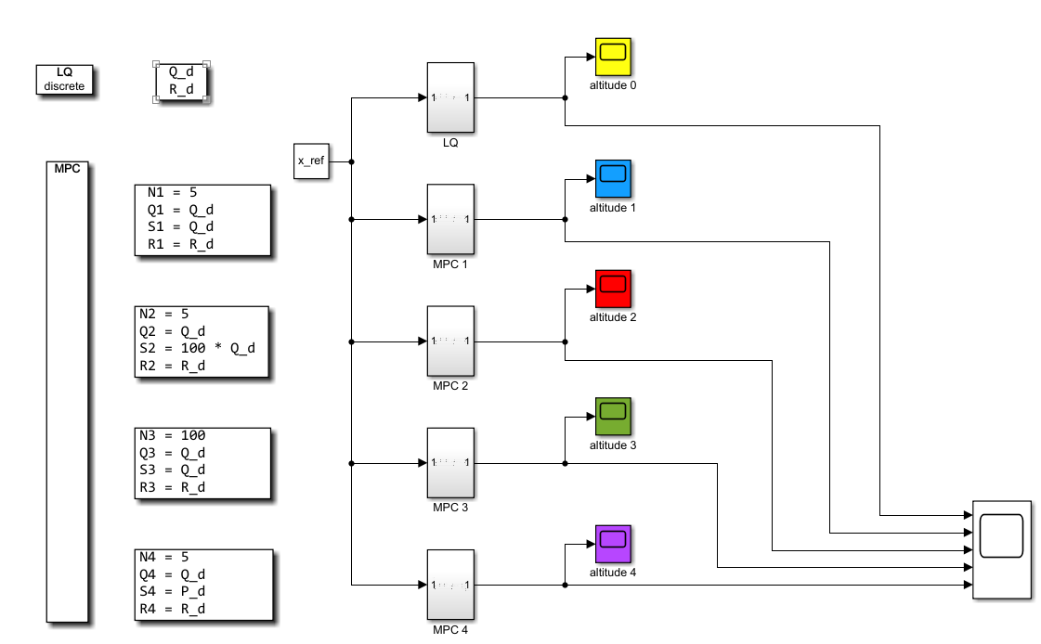
MPC without constraints
Simulink Scheme: MPC without constraints (Q_d$=Q_{4}$, R_d=$R_{4}$)
Simulink Scheme: MPC without constraints (Q_d=𝑄_4, R_d=𝑅_4)

Slide 19
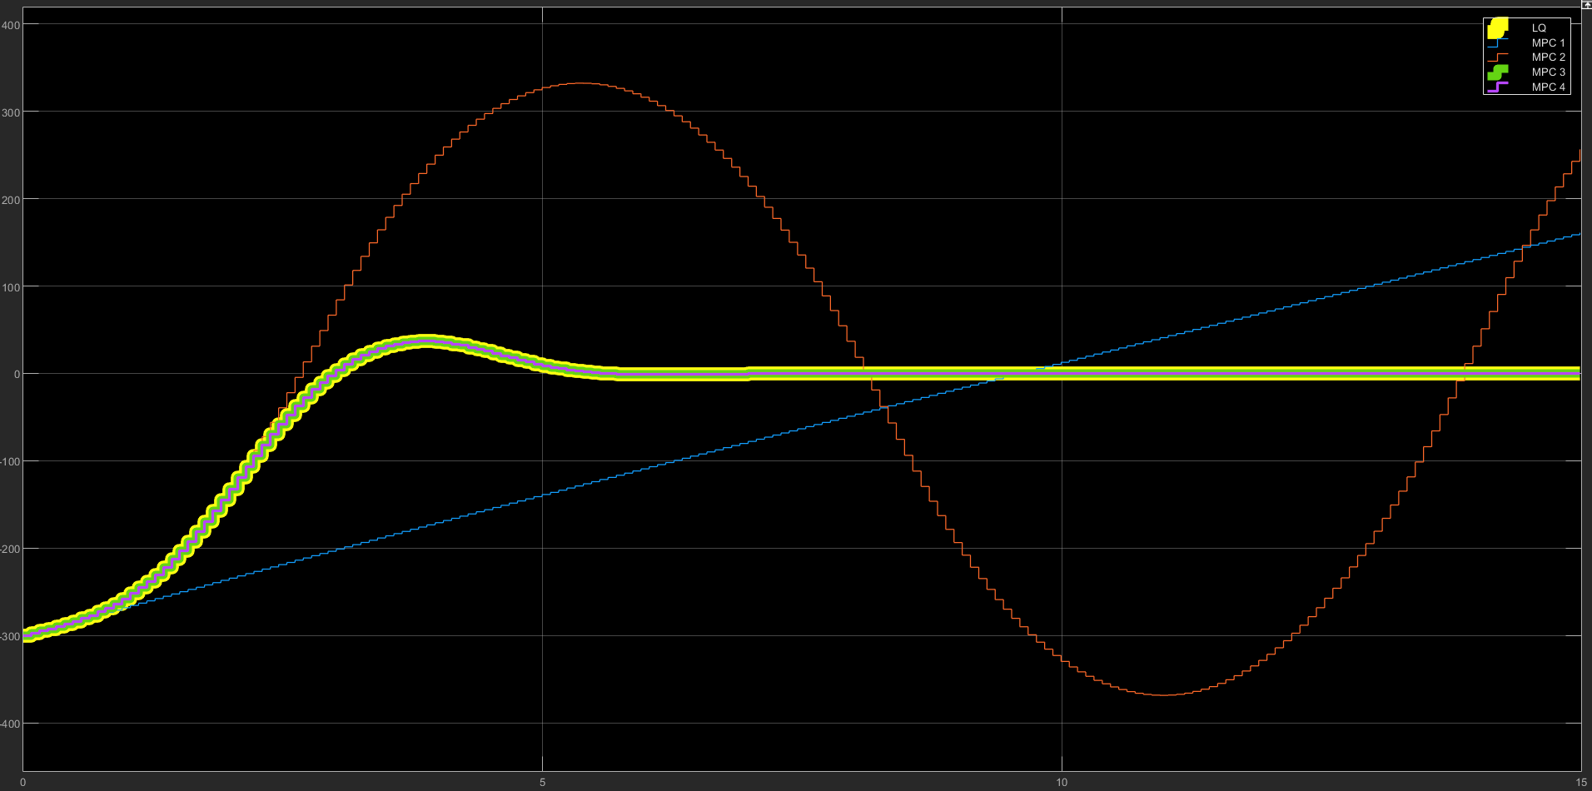
MPC without constraints
Results for MPC without constraints

Slide 20
MPC with Control Constraints
Control Constraints
$u_{min}≤u\left(k\right)≤u_{max} ∀k$
𝑢_𝑚𝑖𝑛≤𝑢(𝑘)≤𝑢_𝑚𝑎𝑥 ∀𝑘
$A_{u}u\left(k\right)≤b_{u} ∀k∈[0;N−1]$
𝐴_𝑢 𝑢(𝑘)≤𝑏_𝑢 ∀𝑘∈[0;𝑁−1]
${\hat{A}}_{u}=\left[\begin{matrix}A_{u} & 0 & ⋯ & 0 \\ 0 & A_{u} & ⋯ & 0 \\ ⋮ & ⋮ & ⋱ & ⋮ \\ 0 & 0 & ⋯ & A_{u}\end{matrix}\right], {\hat{b}}_{u}=\left[\begin{matrix}b_{u} \\ b_{u} \\ ⋮ \\ b_{u}\end{matrix}\right]$
𝐴 ̂_𝑢=[■8(𝐴_𝑢&0&⋯&0@0&𝐴_𝑢&⋯&0@⋮&⋮&⋱&⋮@0&0&⋯&𝐴_𝑢 )], 𝑏 ̂_𝑢=[■8(𝑏_𝑢@𝑏_𝑢@⋮@𝑏_𝑢 )]
$${\hat{A}}_{u}U(k)≤{\hat{b}}_{u}$$
𝐴 ̂_𝑢 𝑈(𝑘)≤𝑏 ̂_𝑢
States Constraints
$A_{x}x\left(k\right)≤b_{k} ∀k∈[1;N]$
𝐴_𝑥 𝑥(𝑘)≤𝑏_𝑘 ∀𝑘∈[1;𝑁]
$${\hat{A}}_{x}=\left[\begin{matrix}A_{x} & 0 & ⋯ & 0 \\ 0 & A_{x} & ⋯ & 0 \\ ⋮ & ⋮ & ⋱ & ⋮ \\ 0 & 0 & ⋯ & A_{x}\end{matrix}\right], {\hat{b}}_{x}=\left[\begin{matrix}b_{x} \\ b_{x} \\ ⋮ \\ b_{x}\end{matrix}\right]$$
𝐴 ̂_𝑥=[■8(𝐴_𝑥&0&⋯&0@0&𝐴_𝑥&⋯&0@⋮&⋮&⋱&⋮@0&0&⋯&𝐴_𝑥 )], 𝑏 ̂_𝑥=[■8(𝑏_𝑥@𝑏_𝑥@⋮@𝑏_𝑥 )]
$${\hat{A}}_{x}X\left(k\right)≤{\hat{b}}_{x}↔{\hat{A}}_{x}(𝒜x\left(k\right)+ℬU\left(k\right))≤{\hat{b}}_{x}$$
𝐴 ̂_𝑥 𝑋(𝑘)≤𝑏 ̂_𝑥↔𝐴 ̂_𝑥 (𝒜𝑥(𝑘)+ℬ𝑈(𝑘))≤𝑏 ̂_𝑥
$x_{min}≤x\left(k\right)≤x_{max} ∀k≥0$
𝑥_𝑚𝑖𝑛≤𝑥(𝑘)≤𝑥_𝑚𝑎𝑥 ∀𝑘≥0

Slide 21
MPC with Control Constraints
$\hat{A}=\left[\begin{matrix}{\hat{A}}_{x}ℬ \\ {\hat{A}}_{u}\end{matrix}\right]$, $\hat{b}=\left[\begin{matrix}{\hat{b}}_{x}−{\hat{A}}_{x}𝒜x(k) \\ {\hat{b}}_{u}\end{matrix}\right]$
𝐴 ̂=[■8(𝐴 ̂_𝑥 ℬ@𝐴 ̂_𝑢 )], 𝑏 ̂=[■8(𝑏 ̂_𝑥−𝐴 ̂_𝑥 𝒜𝑥(𝑘)@𝑏 ̂_𝑢 )]
$$\hat{A}U(k)≤\hat{b}$$
𝐴 ̂𝑈(𝑘)≤𝑏 ̂
Control Constraints States Constraints

Slide 22
Displacement diagrams
Modified trapezoidal

Slide 23
Motion Curve 01: Feeding Group
0° → 80° Rise
80° → 360° Dwell

Slide 24
Motion Curve 02: Pressing Group
0°→90° Ground
90°→135° Rise
135°→305° Dwell
305°→350° Fall
350°→360° Ground

Slide 25
Motion Curve 03: Cutting Group
0°→145° Ground
145°→220° Rise
220°→295° Fall
295°→360° Ground

Slide 26
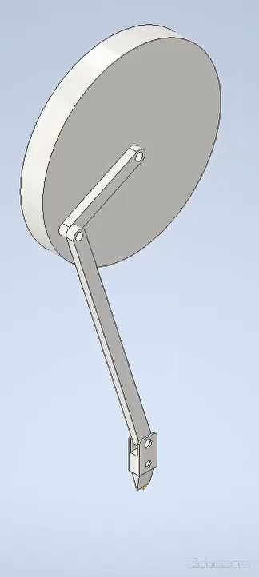
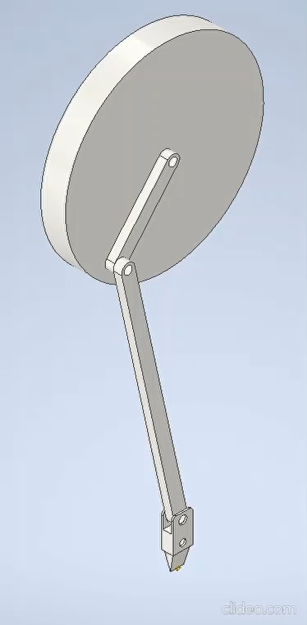
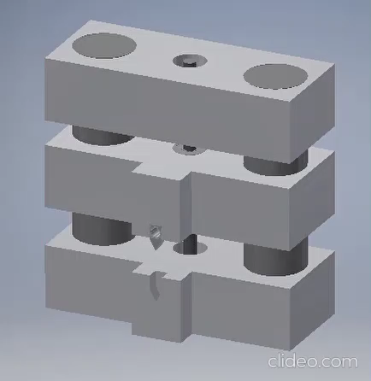
Cutting group
Crank slider continuous
Crank slider go and return
Ball screw

Slide 27
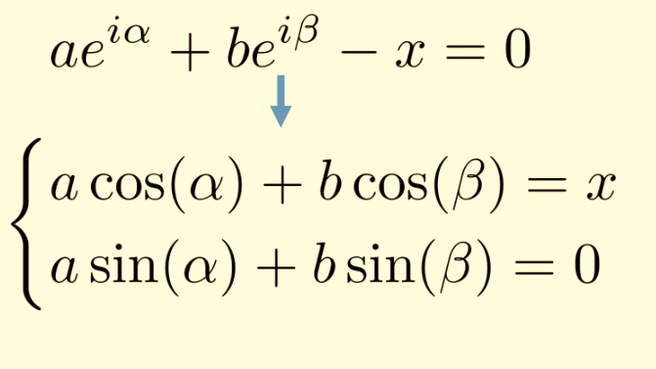
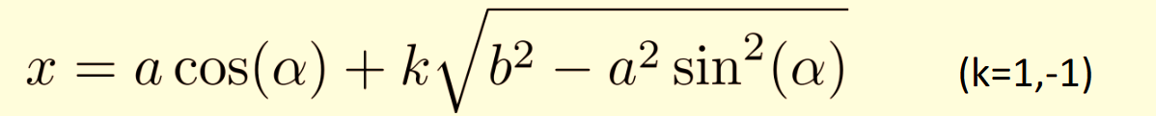

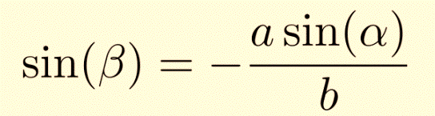
Crank slider continuous
Connecting rod (b) 150 mm
Crank (a) 50 mm

Slide 28

Kinematics and dynamics Crank slider continuous
$$ω_{cycle}$$
$$=$$
$60 pieces/min$
$$\dot{α}= ω_{cycle}$$
Notes:
Cut resistance 15000N same independent from the section of the wire

Slide 29
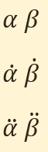
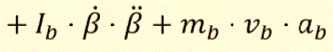
Crank slider go and return
Connecting rod (b) 150 mm
Crank (a) 50 mm
Power balance
Inverse
kinematics

Slide 30
Kinematics and dynamics Crank slider go and return

Slide 31
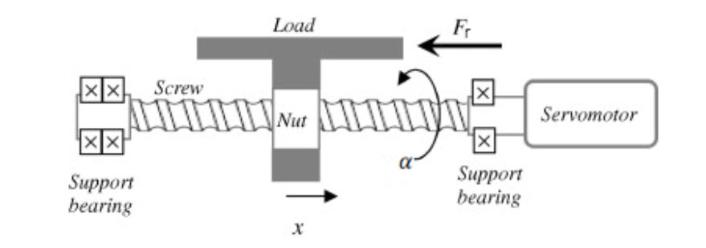
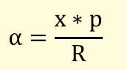
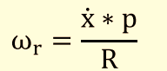
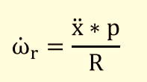
Ball screw
Pitch of the screw (p) 2 mm
Trapezoidal screw M20 R = 10 mm
Inverse
kinematics

Slide 32
Kinematics and dynamics Ball screw

Slide 33
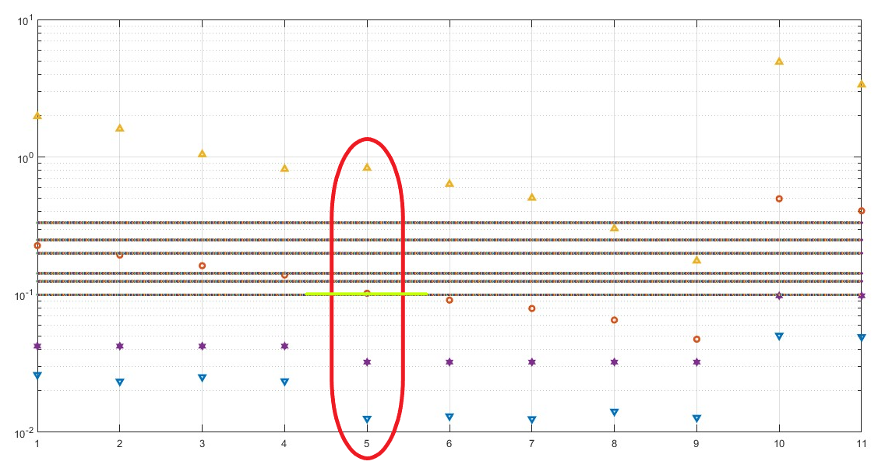
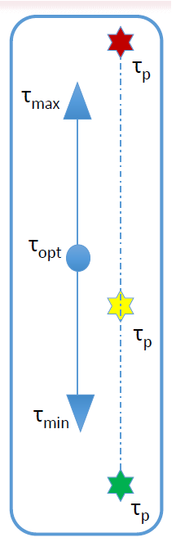

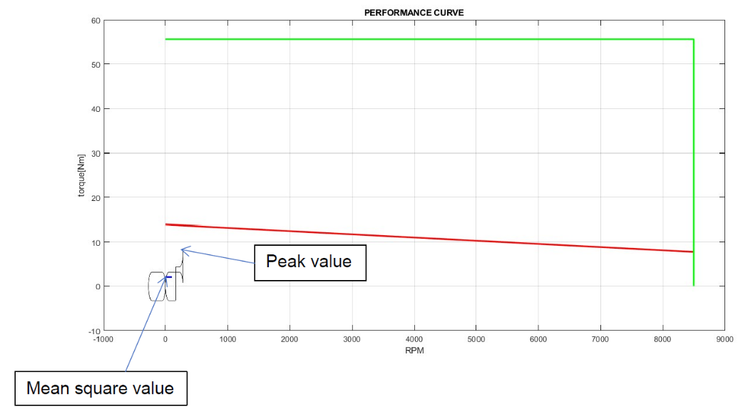

Motor-reducer sizing: ball screw (alpha and beta procedure)
$$∆x_{4}=300 m$$
Chosen
Motor 5
Reducer 6

Slide 34
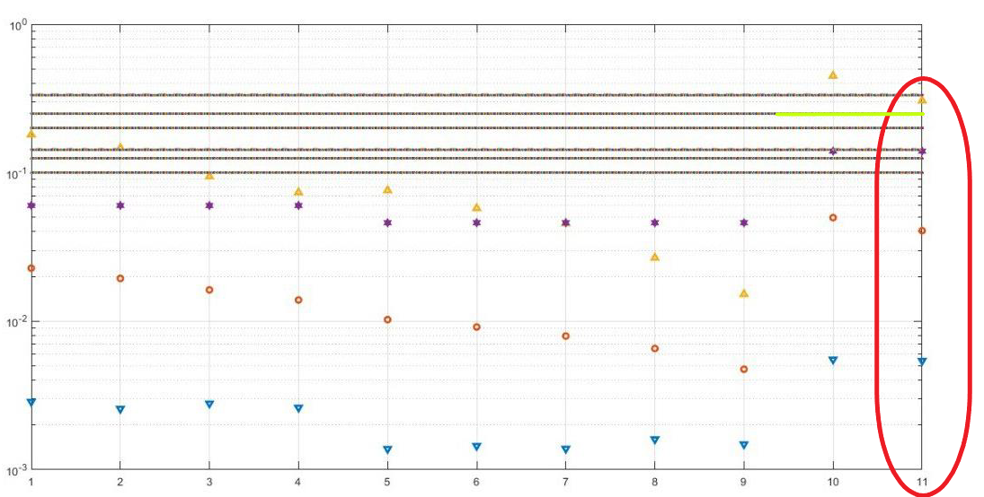
Motor-reducer sizing: crank slider go and return (alpha and beta procedure)
Chosen
Motor 11
Reducer 2

Slide 35
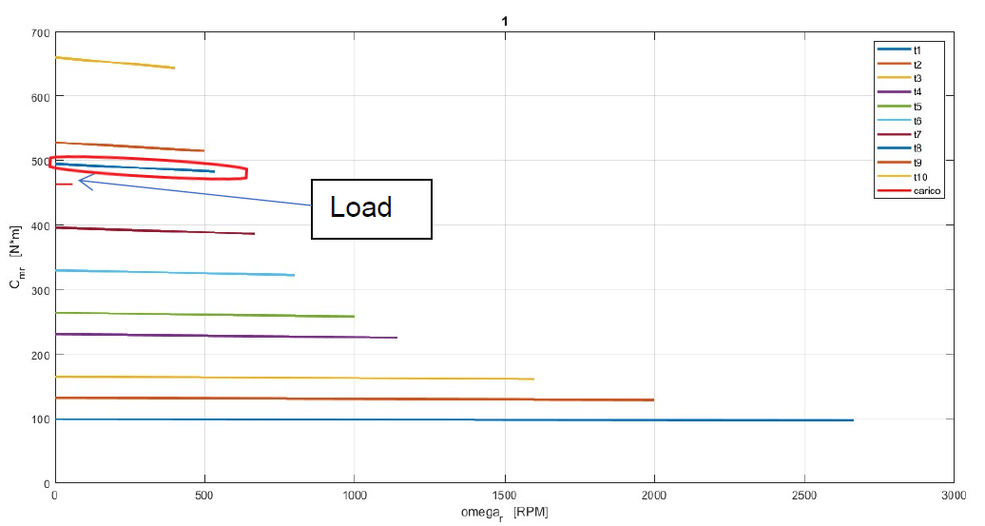
Motor-reducer sizing: Crank slider continuous (static dimensioning)
Chosen
Motor 1
Reducer 8

Slide 36
Performance analysis
Different cutting length

Slide 37
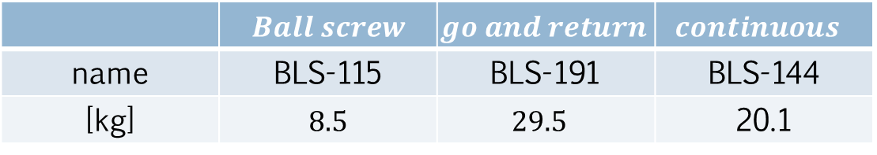
Performance analysis
Comparison of motor weights
 | $$Ball screw$$ | $go and return$ | $$continuous$$
name | BLS-115 | BLS-191 | BLS-144
[kg] | $$8.5$$ | $$29.5$$ | 20.1

Slide 38
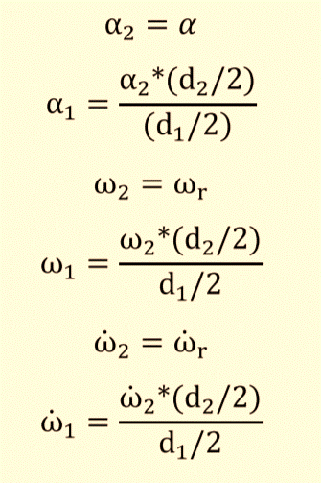
Possible improvements
Inverse
kinematics

Slide 39
Thank you for your attention!
Crippa Davide 509769
Moroni Gianluca 503424
Mongini Paolo 507997

